Slide 1









Emotion-Driven Music Recommendation - Using Deepface and Deep Learning
In AlTAIR AI STUDIO
This combines facial emotion recognition (DeepFace) with a song emotion classifier to deliver personalized, adaptive music recommendations mapped to Spotify tracks by reading faces.
According to facial emotions, the songs in the datasets will be suggested
Github Link: Here
Youtube Link: Here Kaggle Dataset: Here
Notes:
1

Slide 2
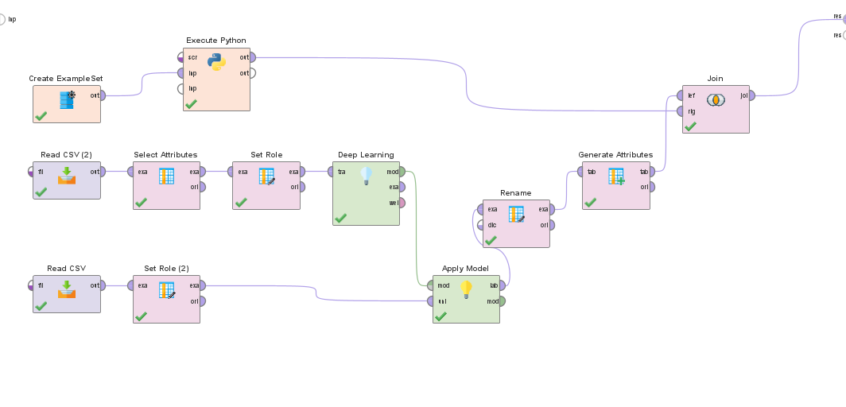
Process Architecture- Entire Workflow
Deepface
Image input
Face img
4.Inner Joining both outputs
Kaggle Dataset
songs.csv
Test Dataset Test.csv
3. Emotion in Test Songs are predicted
2. DeepLearning
Notes:
3

Slide 3

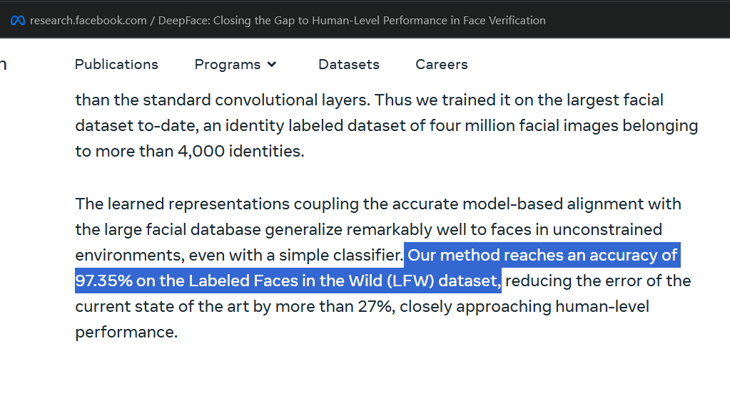
Component A — Facial Emotion Detection (DeepFace)
Model: DeepFace . Selected for robust facial feature extraction and high benchmark accuracy.
Supported emotions: happy, sad, neutral (mapped from detailed DeepFace outputs)
Reported accuracy: up to 97.35% on standard datasets
Inference: lightweight GPU/CPU options for edge or server deployment
Notes:
4

Slide 4
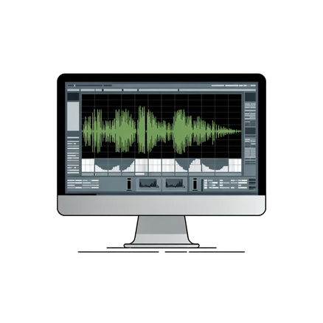
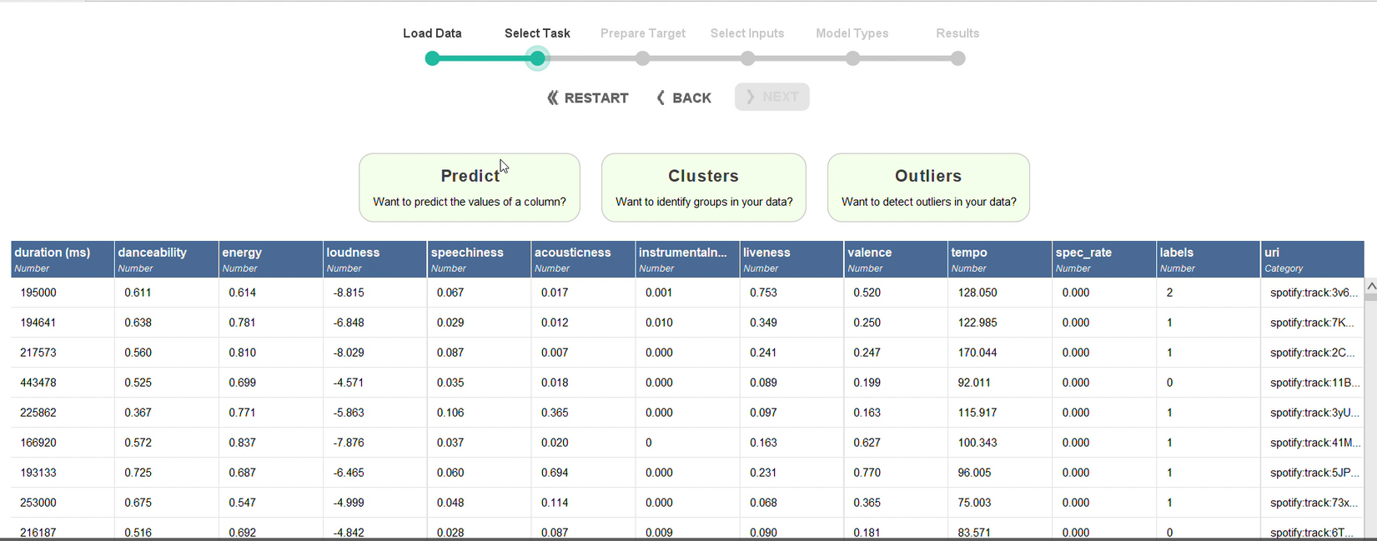
Component B — Song Emotion Classifier
Data: Kaggle dataset with >2 Lakh 78K rows containing audio features (danceability, energy, loudness, acousticness, instrumentalness, valence, etc.).
Label consolidation: energetic + happy merged to improve class separability
Cleaning: Turbo Prep used for deduplication, imputation, and normalization
278k Emotion Labeled Spotify Songs
https://www.kaggle.com/datasets/abdullahorzan/moodify-dataset
DL Model selection: Auto Model in Altair AI Studio identified optimal architecture
Notes:
5

Slide 5
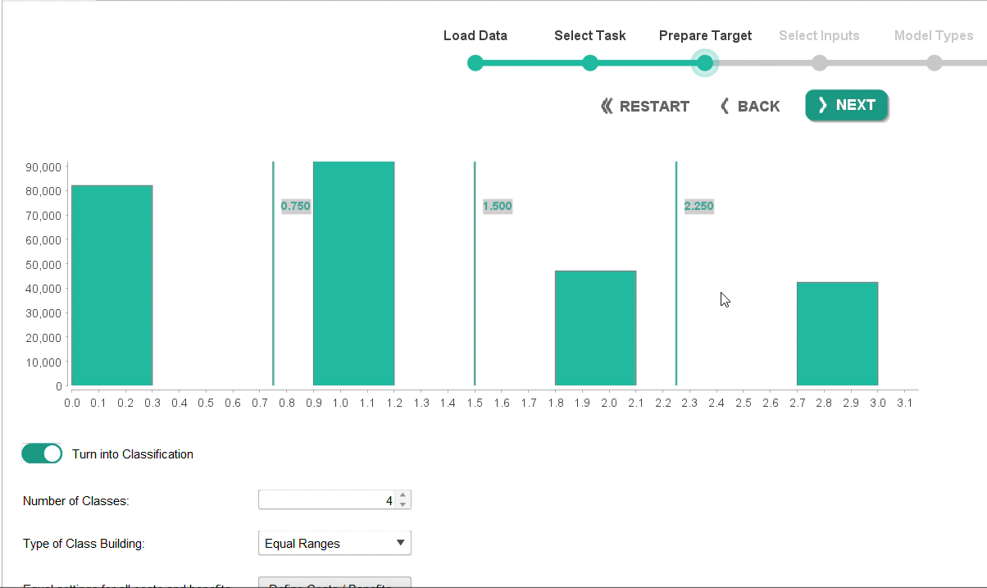
Training & Evaluation
Split: 70% train / 30% test
Cross-validation used during model search
Metrics: precision, recall, F1 per emotion class
Feature engineering: Removed columns except danceability, energy, acousticness, instrumentalness, valence, and speechiness, Z- Normalisation
Representative model metrics from test split after feature tuning and class consolidation.
Notes:
6

Slide 6




Integration & Workflow
1. Capture
2. Detect Emotion
Acquire user image from webcam or mobile camera.
Here, Image path is specified
DeepFace returns granular emotions; map to {happy, sad, neutral}.
3. Classify Songs
4. Recommend
Model predicts song emotion label from audio features.
Join detection result and classifier output;
return Spotify track URI.
The previously shown dataset is for training the DL model to classify songs based on features
The below dataset (Test.csv) is passed into the trained model to classify below songs as Happy, sad, neutral
Test.csv
If deepface output is Happy, happy song link is shown
if deepface output is neutral, neutral song link is shown
if sad, sad song is played
Notes:
7

Slide 7





Example Matches given in the Video
Happy
Neutral
Sad
Video Link: https://youtu.be/G-pFdPKIv_A
Notes:
8

Slide 8





Conclusions
1. Key Achievements
Seamlessly merged two complex AI components and Deep Learning Classification within the Altair Studio workflow environment.
Achieved a high System Accuracy of 97.35% (enhanced by DeepFace's precision), demonstrating robust real-time prediction capabilities.
Overcame significant dependency challenges (TensorFlow/Keras/DeepFace compatibility) to deliver a working, end-to-end solution.
Successfully linked unstructured facial data (images) with structured music feature data (Spotify Audio Features) to generate a personalized output.
2. Use cases
Driver Safety/Alertness: If drowsiness or high anger is detected, the system plays high-energy, alertness-boosting music or sounds an alert.
Mental Health & Therapeutic Tools: Deploy in therapeutic apps to provide background music that either matches a user's calm state (for focus) or gradually introduces happy music to help shift a prolonged sad state (Mood Management).
Customer Service/Retail Experience: (Experience Enhancement) Use subtle emotion detection at kiosks or service desks to gauge user satisfaction and adapt the ambient background music or service approach accordingly.
Real-Time Integration: Migrate the system to a web application for live webcam emotion detection and immediate music playback via the Spotify API.
Notes:
10

